Slide 1
Multistep electric vehicle charging station occupancy prediction using hybrid LSTM neural networks
Kushal Banda, SE20UARI086
Rohan Sagar, SE20UARI125
Sai Sujith, SE20UARI132
Sarath.L, SE20UARI137
Vishwanath.G, SE20UCSE229

Slide 2
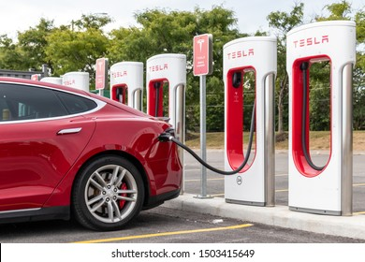
Abstract
Public charging station occupancy prediction plays key importance in developing a smart charging strategy to reduce electric vehicle (EV) operator and user inconvenience. we propose a hybrid LSTM neural network that combines both LSTM and forward neural networks to merge het- erogeneous features for the prediction of EV charging occupancy over a planning horizon. . The proposed method produces very accurate predictions (99.99% and 81.87% for 1 step (10 min) and 6 steps (1 h) ahead, respectively, and outperforms the benchmark approaches.
Abstract

Slide 3
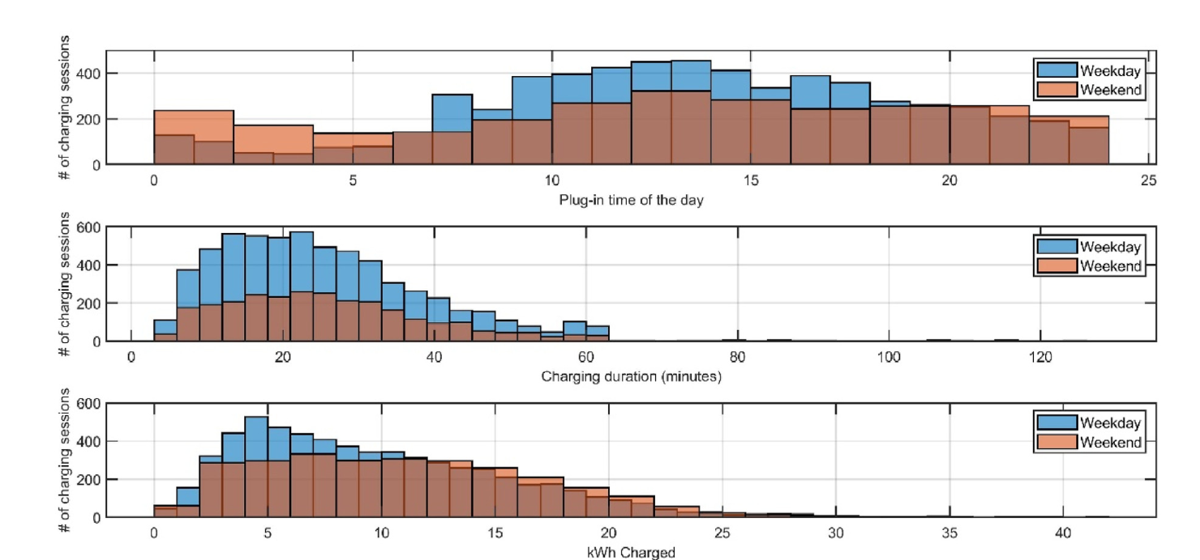
CHARGING DISTRIBUTIONS
Predicting charging occupancy patterns allows charging service platforms to better manage the limited charging resources available and reduce a customer's charging waiting time loss.
The graph shows the ‘Distribution of EV plug-in times, charging duration, and energy charged using rapid chargers on weekdays and weekends.’

Slide 4
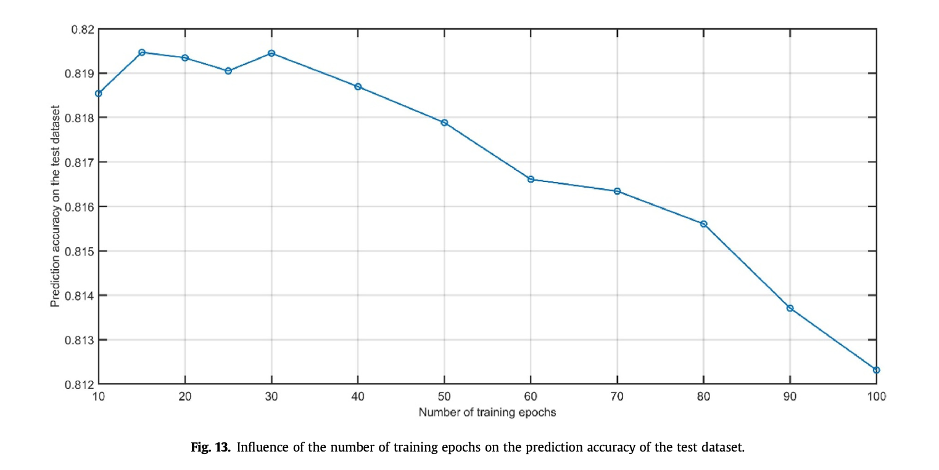
Conclusion
An open dataset provided by the city of Dundee, UK, is used as a basis to implement our approach and verify its performance. This method is compared with four other machine learning methods and three other DL networks. In all cases, the accuracy rate and F1 score show higher performance, both for short-term prediction (10 min: þ22% improvement over the best competing approach) and long-term predictions.

